Slide 1

Cost Efficient Automated Pisciculture Assistance System Using Internet of Things (IoT)
North South University, Dhaka, Bangladesh

Slide 2
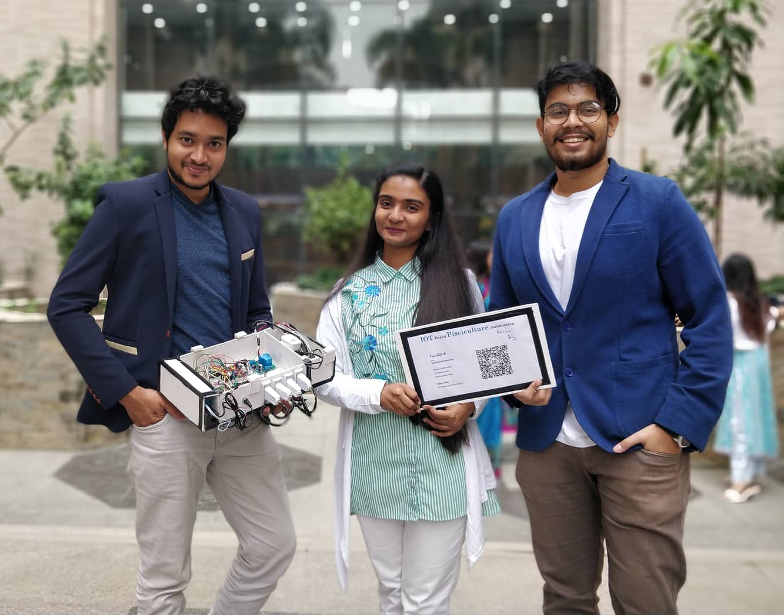

Project Team
Mehboob Hasan Rohit, BS CSE Candidate, North South University
Zarin Tarannum Hoque, BS CSE Candidate, North South University
S M Mujibul Karim, BS CSE Candidate, North South University
Supervised by:
Dr. Shahnewaz Siddique
Assistant Professor
North South University, Dhaka

Slide 3
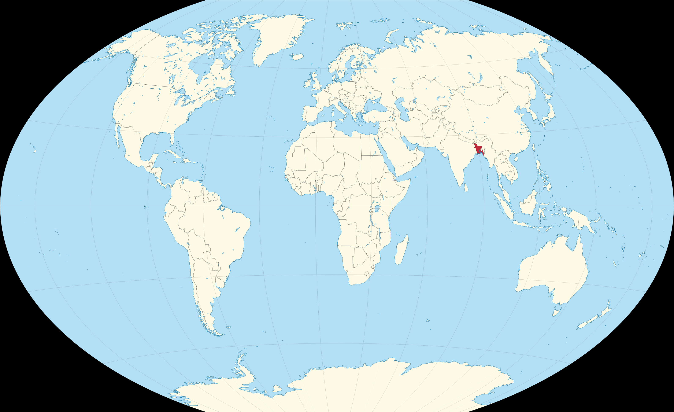





All thanks to the organizers!
Internet

Slide 4
Internet of Things can solve many problems
In a developing country like Bangladesh, there are many domains with opportunities to implement IoT applications and change lives of millions
Agriculture
Industry, and small and medium enterprises
Homes and office life styles
Entertainment
We targeted to solve a problem within PISCICULTURE

Slide 5

Identified problems of the project
Problems within current pisciculture conditions
Sudden temperature fall affects the fishes
pH becomes low because of the excretion of fishes
Water gets damaged because of iron and H₂S
Shortage of oxygen
CO₂ increases
Timely feeding in case of pisciculture is not ensured
Help me!

Slide 6

Solving the problems through IoT
The objective of this project is to solve these problems with the help of IoT technology:
Assistance system
Fully automated
IoT based device
Real time data monitoring capability
Android platform supported
Awesome!

Slide 7

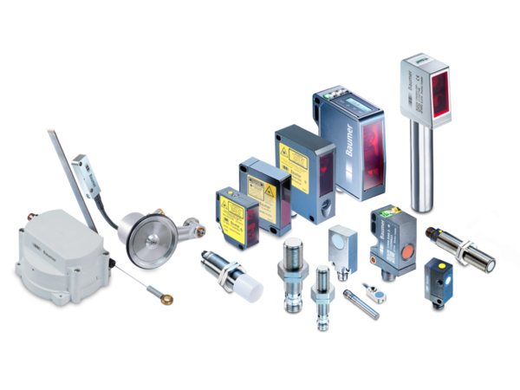
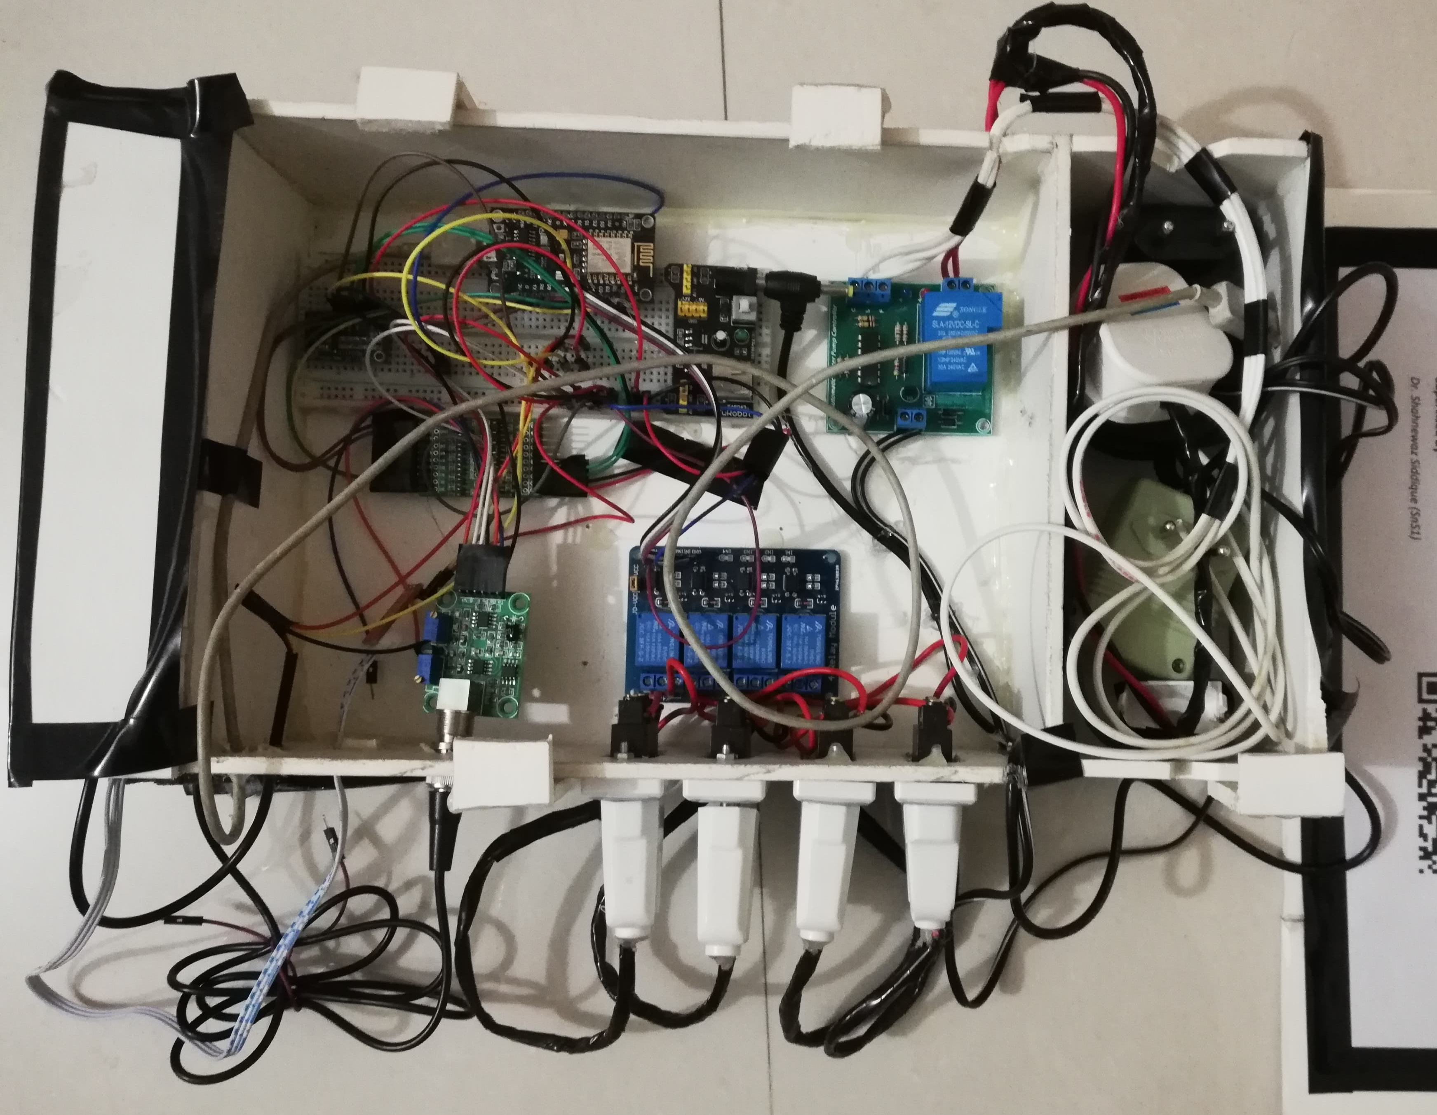
How did we do it?
+
Automated
Pisciculture
Assistance
System
Voila!

Slide 8
SENSORS & MODULES OF THE IOT DEVICE
Temperature Sensor
DS18B20
Wi-fi module
Node MCU
pH
Sensor
Turbidity Sensor
4-channel relay
Automated
Water
Pump

Slide 9
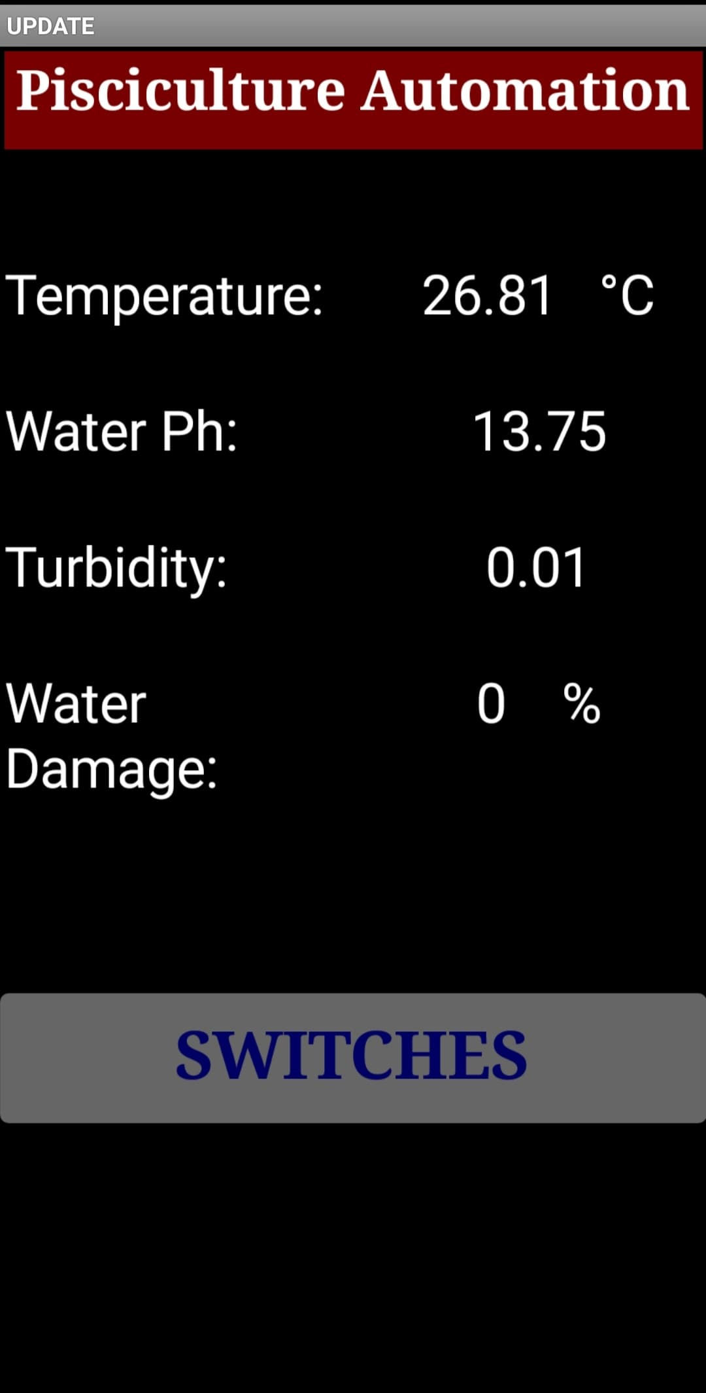
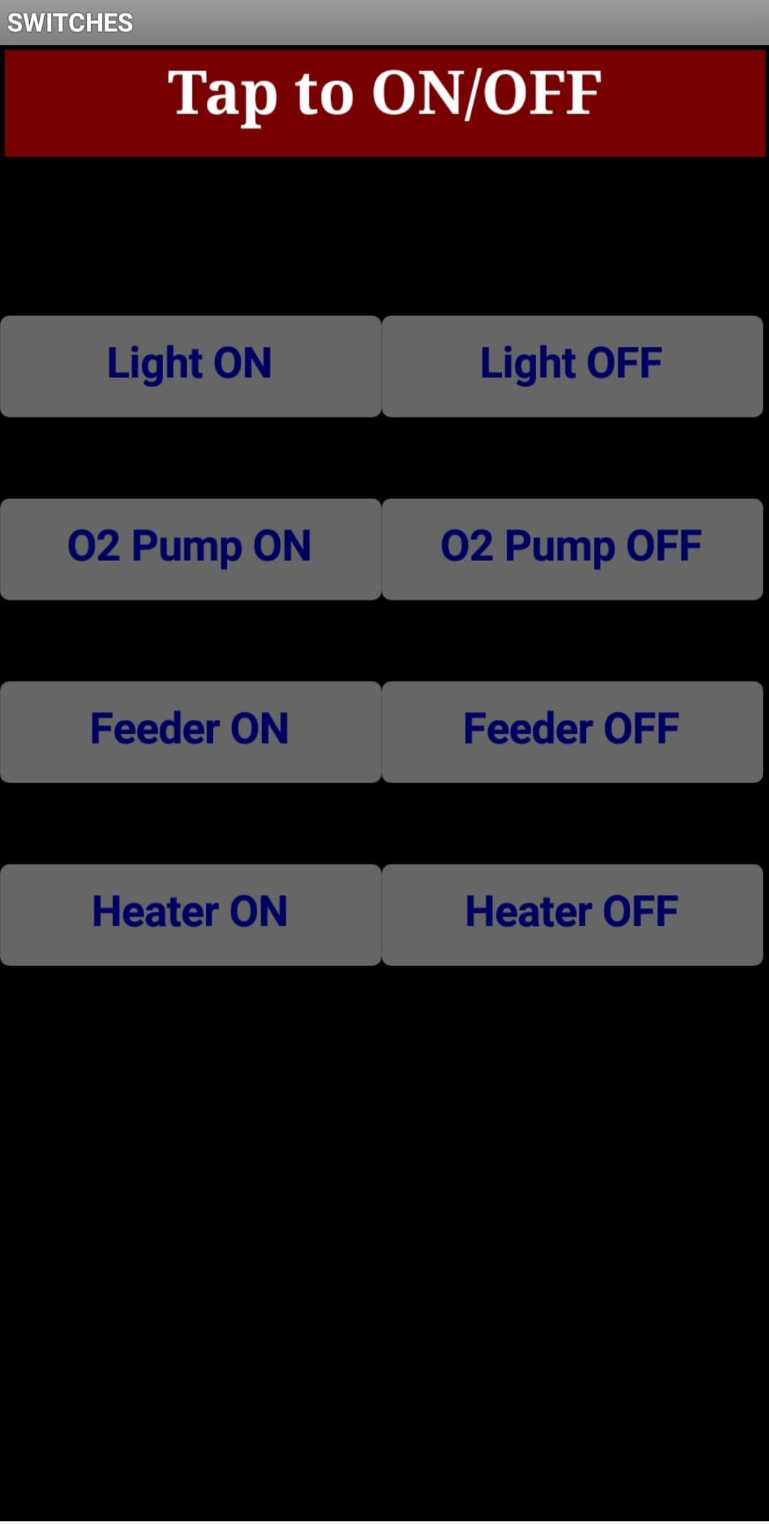
ANDROID APPLICATIONS USED
First page
Second page

Slide 10
IoT ARCHITECTURE OF THE SYSTEM
pH sensor
pH electrode
Turbidity sensor
Control from website
Four appliances
Automated water pump
Turbidity probe
SMS Service
pH module
Oxygen pump
Heater
Liquid level probe
Water
pump
Control
ADS1115
Turbidity module
Webhook
Light
Feeder
Website
12v relay
Logic level shifter
Temperature sensor
Temp
sensor
IFTT
Cayenne MQTT
Micro
controller
Node
MCU
Control
App
Internet
4-channel relay
Android app

Slide 11
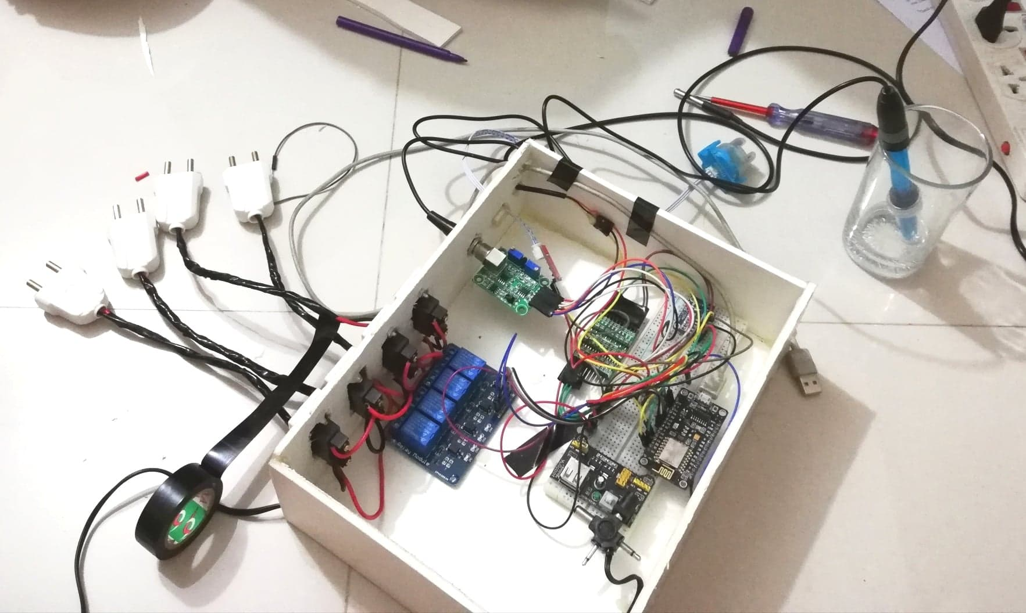
MAIN CIRCUIT OF THE IOT DEVICE
Turbidity Sensor
Logic level shifter
pH Sensor
pH module
ADS 1115
4-channel relay
Node MCU
Breadboard power stick

Slide 12
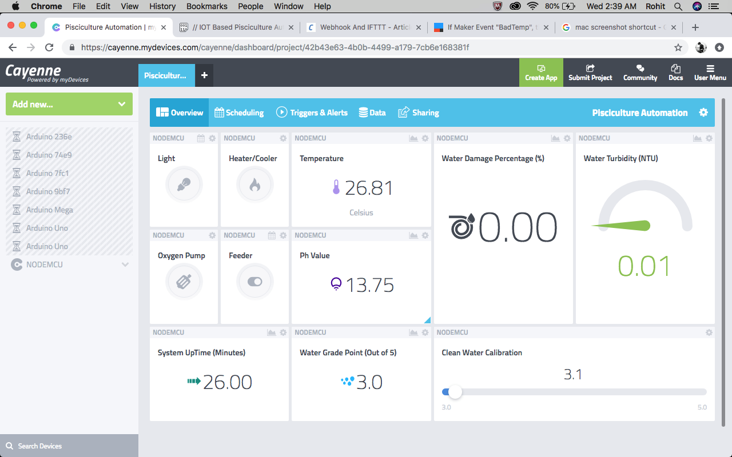
WORKING OF THE AUTOMATED PISCICULTURE ASSISTANCE SYSTEM
IoT device connected to a web portal
Threshold values could be controlled
Readings obtained in real time
Entire library of modules and sensors
Configurable user Interface

Slide 13

COST CALCULATION
Modules and sensors | Bangladeshi Taka | USD
NODEMCU | 350.00 | 4.15
4 Channel ISO Relay | 250.00 | 2.96
Logic Level Shifter | 150.00 | 1.78
I2C 16 bit ADS | 650.00 | 7.71
Power stick board (5V,3V) | 115.00 | 1.36
pH Module | 2,230.00 | 26.44
Turbidity Module | 999.00 | 11.85
Switches, sockets, wires, resistors | 200.00 | 2.37
Variable Power adapter | 218.00 | 2.59
12V DC adapter | 400.00 | 4.74
DS18B20 waterproof temperature sensor | 100.00 | 1.19
12V relay, stand-alone microcontroller | 110.00 | 1.30
TOTAL cost | 5,772.00 | $68.44
Cheaper than Nike’s Air Jordan Legacy 312
$70.97

Slide 14


CONCLUSION AND ACHIEVEMENTS
Limited human engagement
Compact device and portable
Cost effective
Reduce time consumption
Smart instruction and guidance system
Help to grow up economic strength
Easy to operate
Oh yeah!
Oh yeah!

Slide 15





